Slide 1
FUZZY LOGIC
Exploring the concepts of fuzzy logic in real-world applications.

Slide 2
What is the easiest way to get the meaning of Fuzzy Logic?

Slide 3
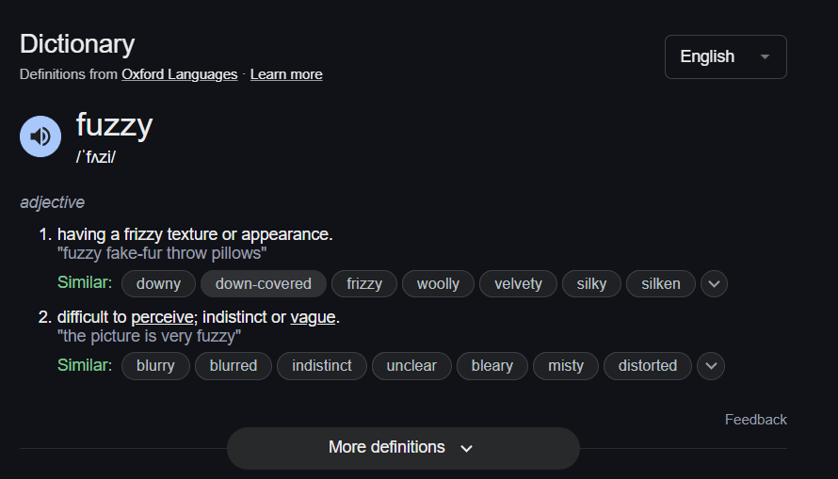

Slide 4
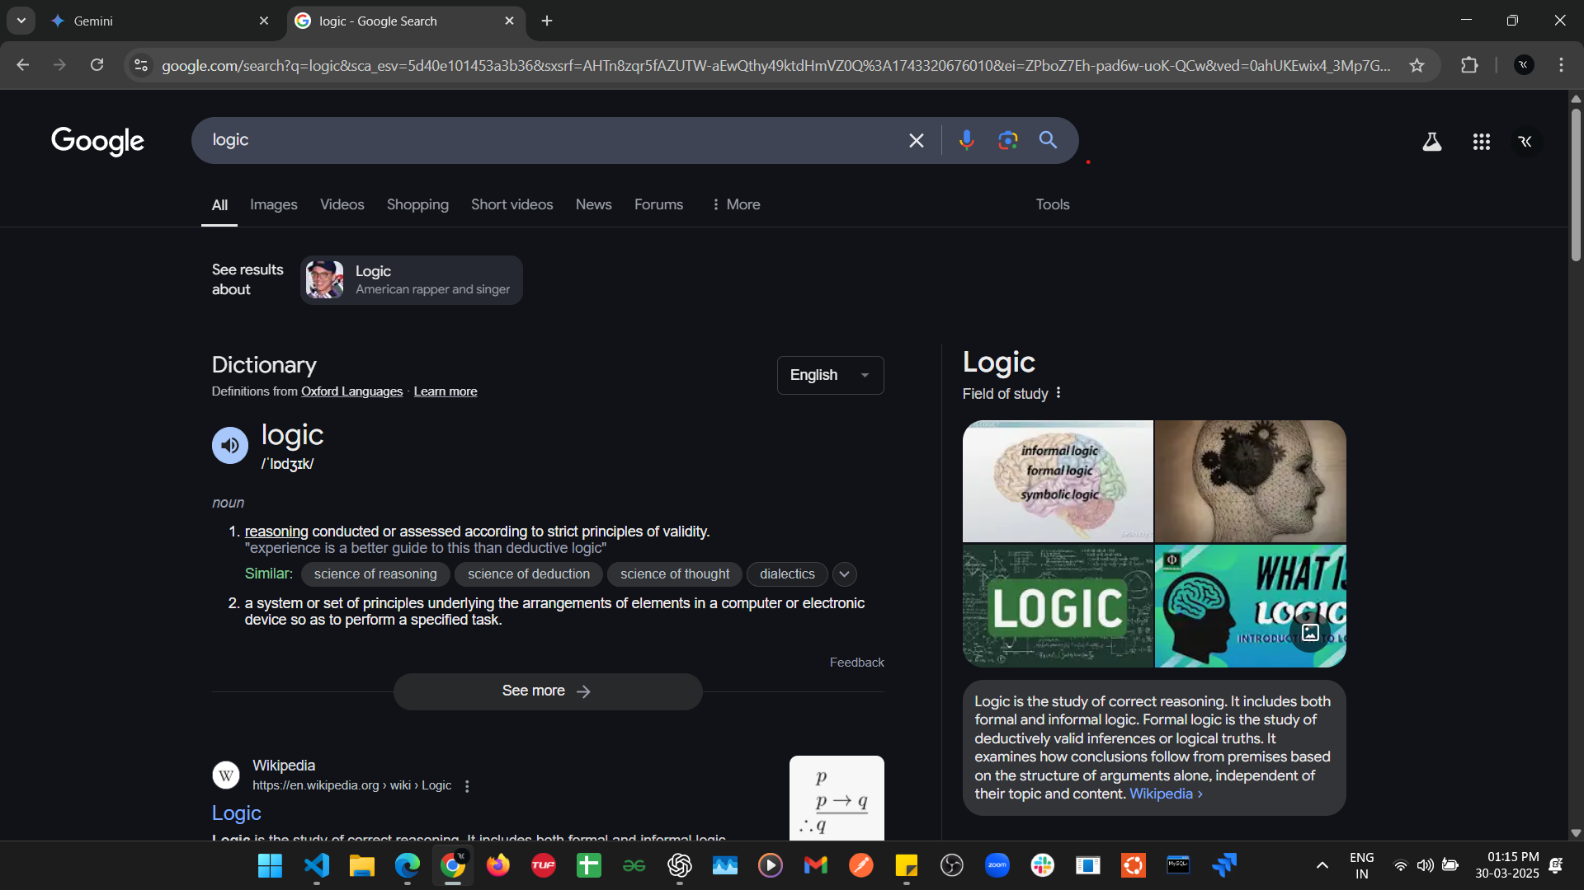

Slide 5
But Still I don’t get the meaning of Fuzzy Logic Completely?
So, I Google the word Completely.

Slide 6
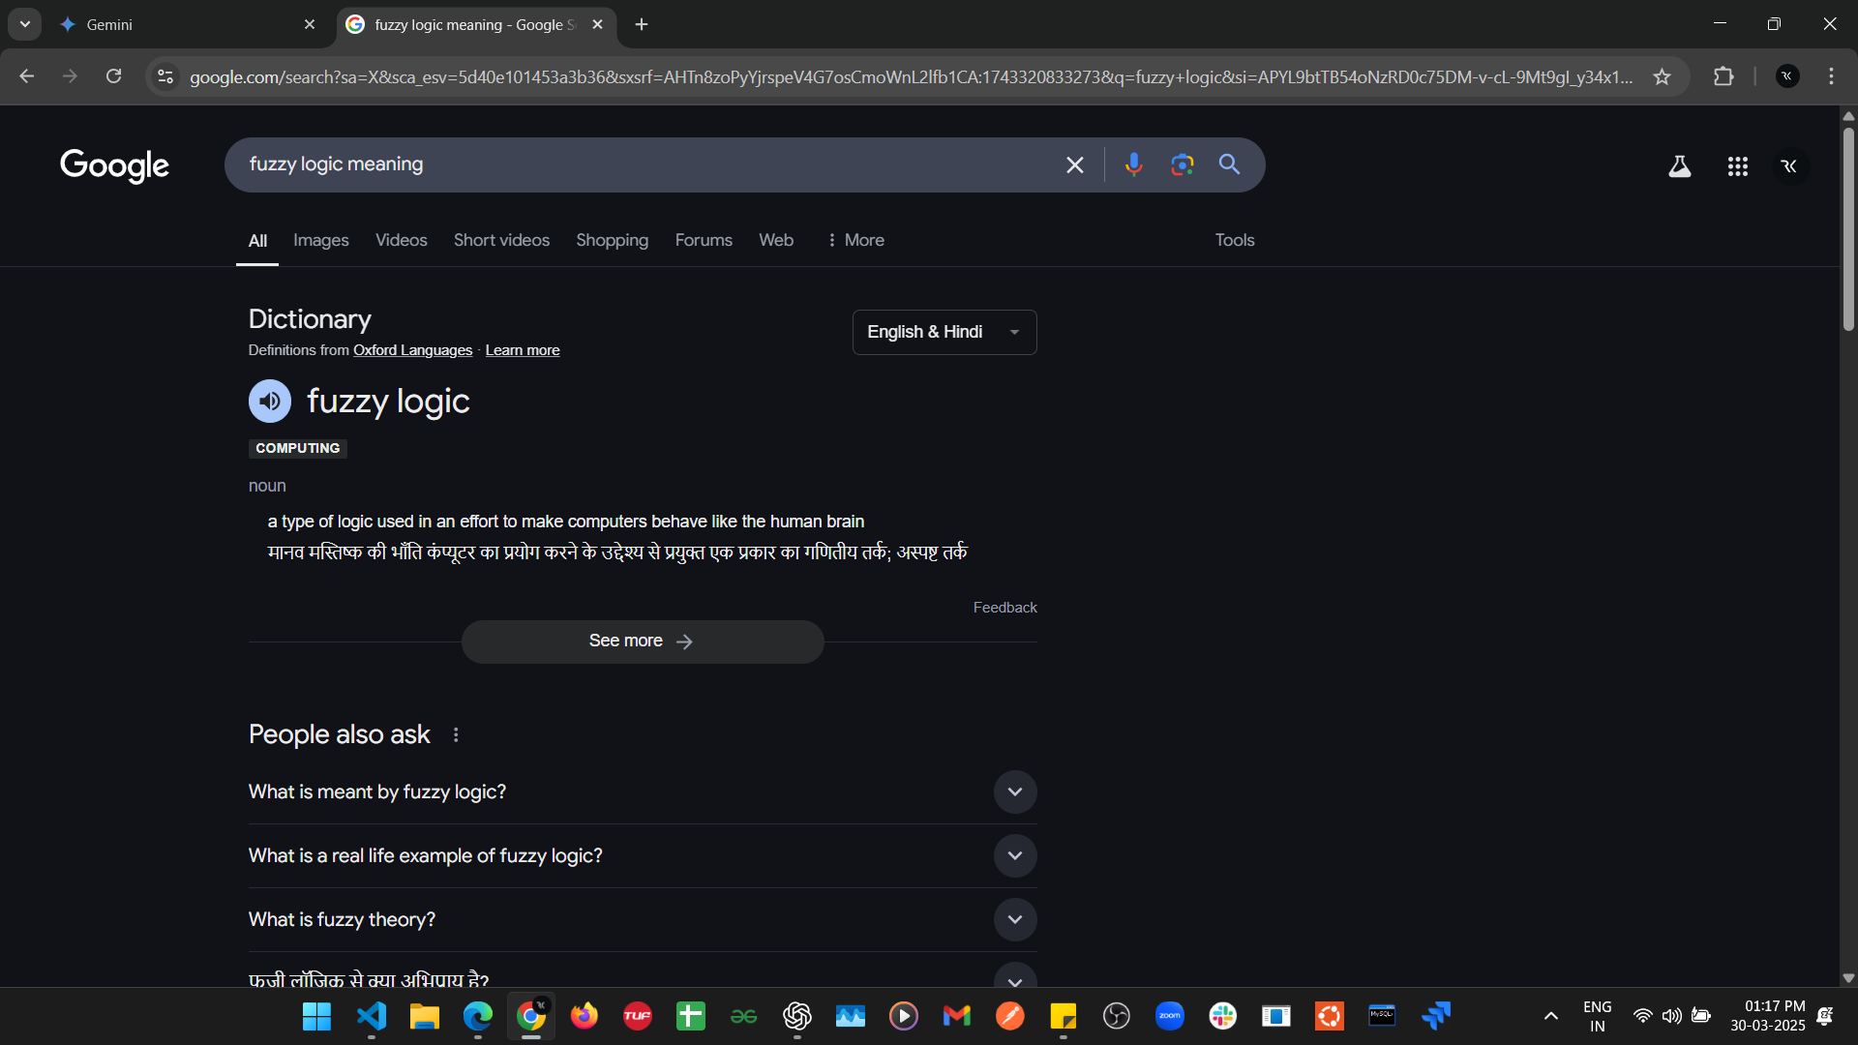

Slide 7
But How Does Computer Behave Like Human Brain?

Slide 8
Let’s Understand This With The Help Of An Example….

Slide 9
How many of you use Instagram?

Slide 10
My IG Algo Knows: 1. Rahul Likes 90% cat videos. 2. Rahul Likes 70% memes. 3. Rahul Likes 80% food videos. So, It Show Me:

Slide 11


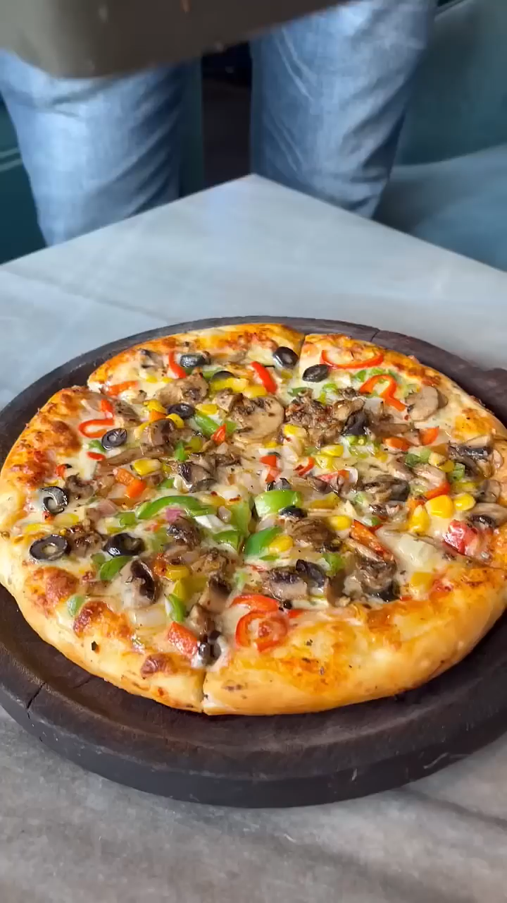
A Cat Video A Meme Video A Food Video

Slide 12
Now, When IG wants to push a new Reel or Pic, then It needs to think what to show? Right!

Slide 13
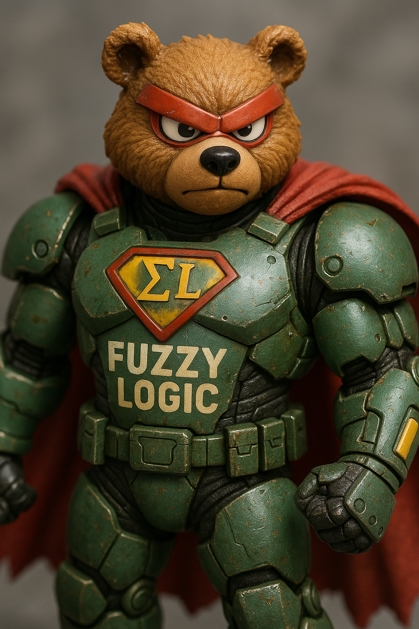
So, to solve that here comes Our Hero FUZZY LOGIC!

Slide 14
And Based Upon the %age it shows me the Reel like a cat video having food and a meme.

Slide 15

A Cat video having Food and a Meme

Slide 16
But now the new question that comes to my mind is how we got the %age right?

Slide 17
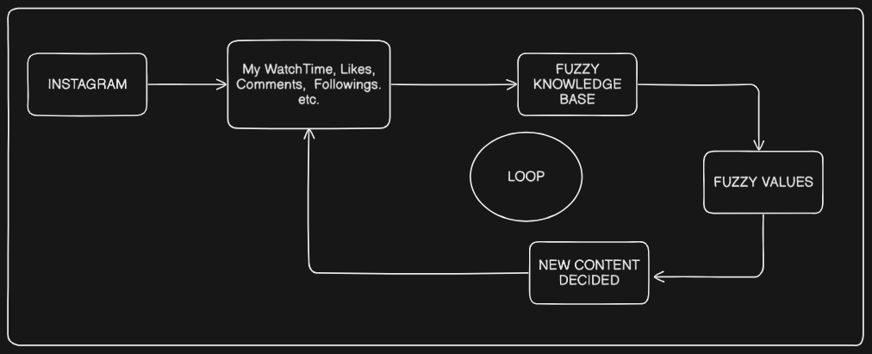

Slide 18
Fuzzy Set

Slide 19
Crisp Set
(just a normal set)
A= {1,2,3,4,5,6,7,8,.......}
Set of Numbers

Slide 20

Universe of Discourse Of Numbers

Slide 21

Universe of Discourse of Cats

Slide 22
Fuzzy Set (Similair to Crisp)

Slide 23
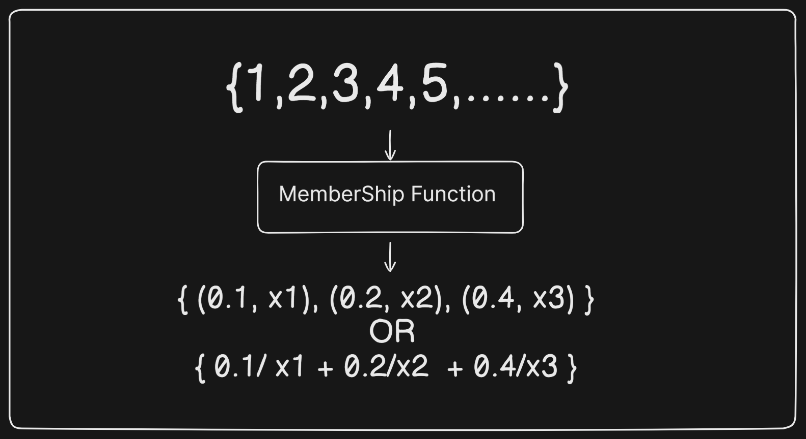
Crisp Set

Slide 24
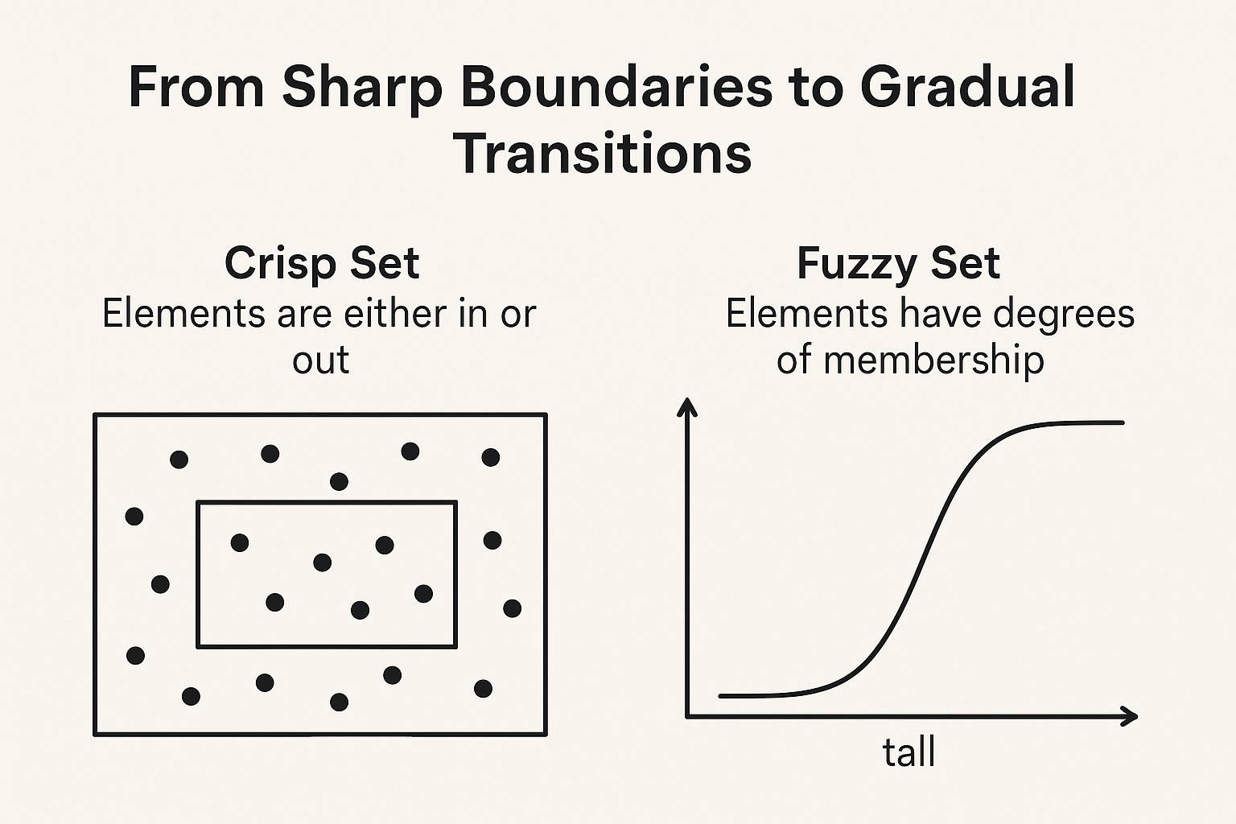

Slide 25
Operations on Fuzzy Set

Slide 26
Operation | Formula (Membership Function μ_A(x))
Union (A ∪ B) | μ_{A ∪ B}(x) = max(μ_A(x), μ_B(x))
Intersection (A ∩ B) | μ_{A ∩ B}(x) = min(μ_A(x), μ_B(x))
Complement (¬A) | μ_{¬A}(x) = 1 - μ_A(x)

Slide 27
https://rahulkumarpahwa.tech/projects/fuzzy-logic

Slide 28
Membership Function

Slide 29
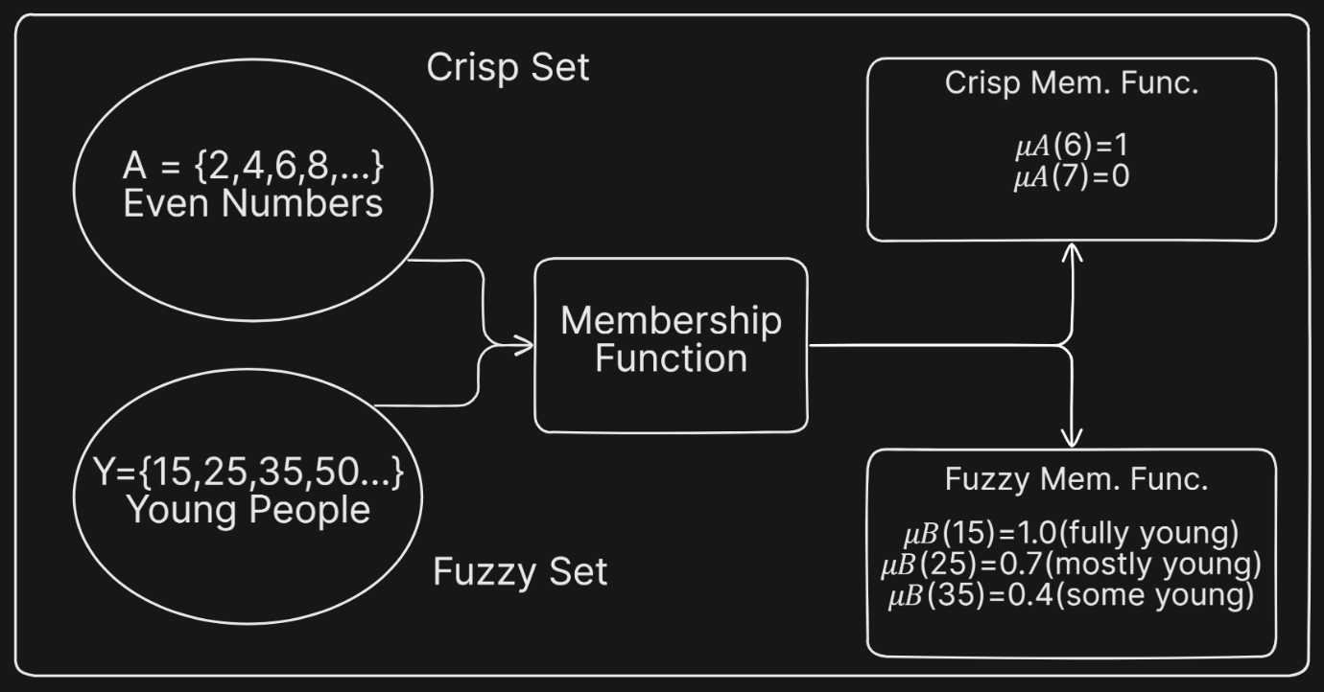

Slide 30
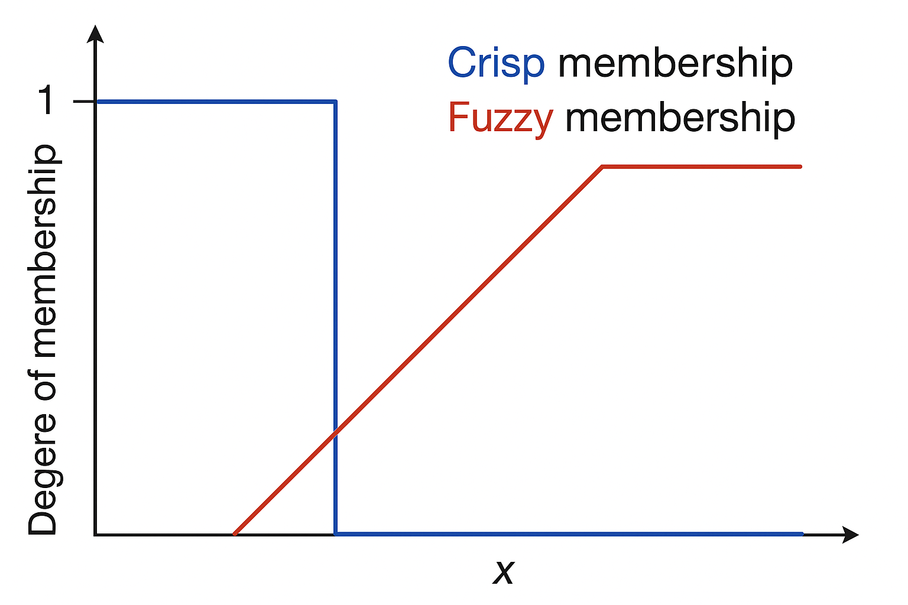

Slide 31
Composition Of
Fuzzy Relations

Slide 32
Composition ≈ Combination

Slide 33
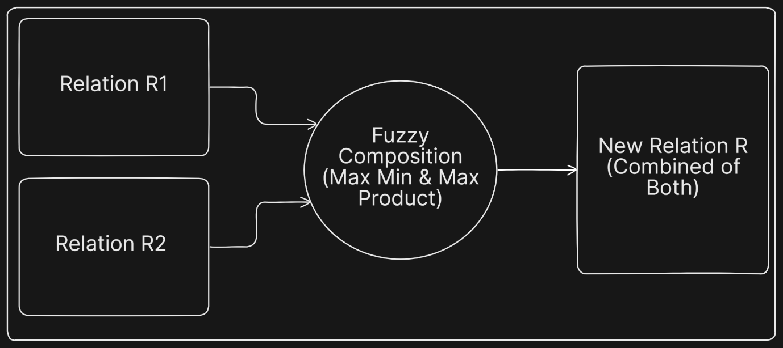

Slide 34
Let’s Understand This With The Help Of An Example….

Slide 35
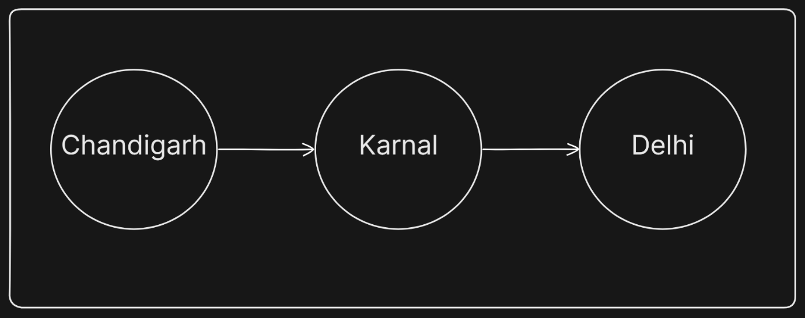
We will Decide the route based upon the road quality.

Slide 36
B : 0.8
(Good
Condition)
C
0.7 (Almost Good)
A
D : 0.6
(Not that Good)
0.5
(May be Good)
E : 0.5
(May be Good)
0.4 (bad)

Slide 37
Now, The Matrix Representation of these will be:
 | C
B | 0.7
D | 0.5
E | 0.4
 | B | D | E
A | 0.8 | 0.6 | 0.5

Slide 38
Max-Min Composition :
For A → B → C:
First link (A → B): 0.8 (from R₁).
Second link (B → C): 0.7 (from R₂).
Minimum = min(0.8, 0.7) = 0.7.
For A → D → C:
First link (A → D): 0.6 (from R₁).
Second link (D → C): 0.5 (from R₂).
Minimum = min(0.6, 0.5) = 0.5.
For A → E → C:
First link (A → E): 0.5 (from R₁).
Second link (E → C): 0.4 (from R₂).
Minimum = min(0.5, 0.4) = 0.4.
Maximum value of all minimums:
max(0.7, 0.5, 0.4) = 0.7.
Best route: A → B → C, with a fuzzy value of 0.7.

Slide 39
Max-Product Composition:
For A → B → C:
Product = 0.8 × 0.7 = 0.56.
For A → D → C:
Product = 0.6 × 0.5 = 0.3.
For A → E → C:
Product = 0.5 × 0.4 = 0.2.
Best route: A → B → C, with a fuzzy value of 0.56.

Slide 40
The composition result tells us the overall quality of the route from City A to City C, considering intermediate cities. This can help decide which route to take when there are multiple options, ensuring the smoothest journey.

Slide 41
Thank You!

